Slide 1
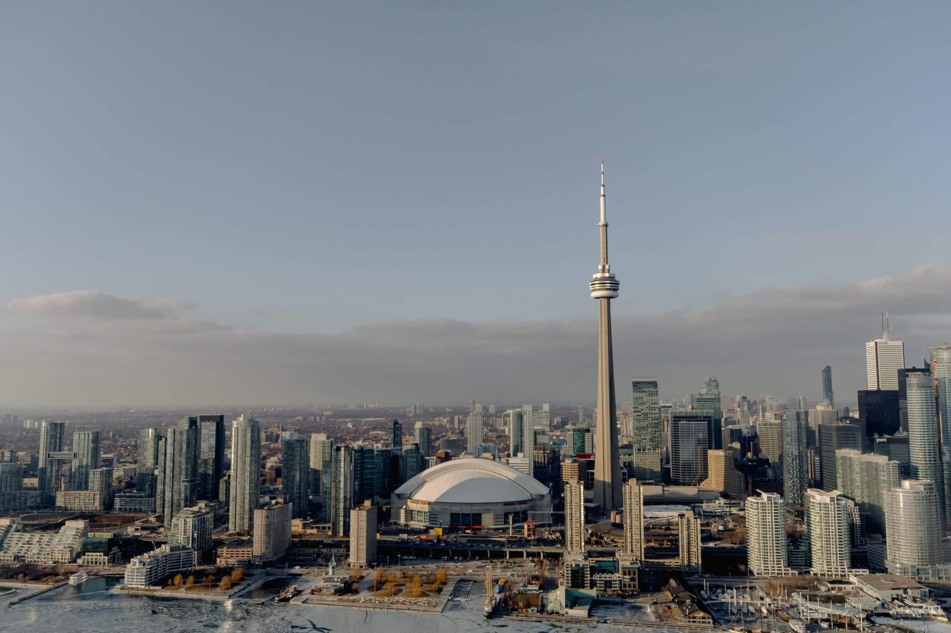

Real Estate Prices GTA Web Scrapping Project
MayOkun ajiboye
Feb 3, 2024

Slide 2
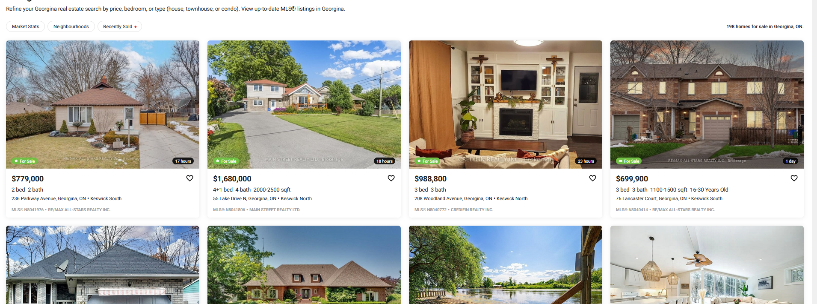
To understanding real estate price variation in the GTA by leveraging web scraping techniques to collect and analyze data. https://zolo.ca structured and organized covers most regions used by many realtor

Slide 3
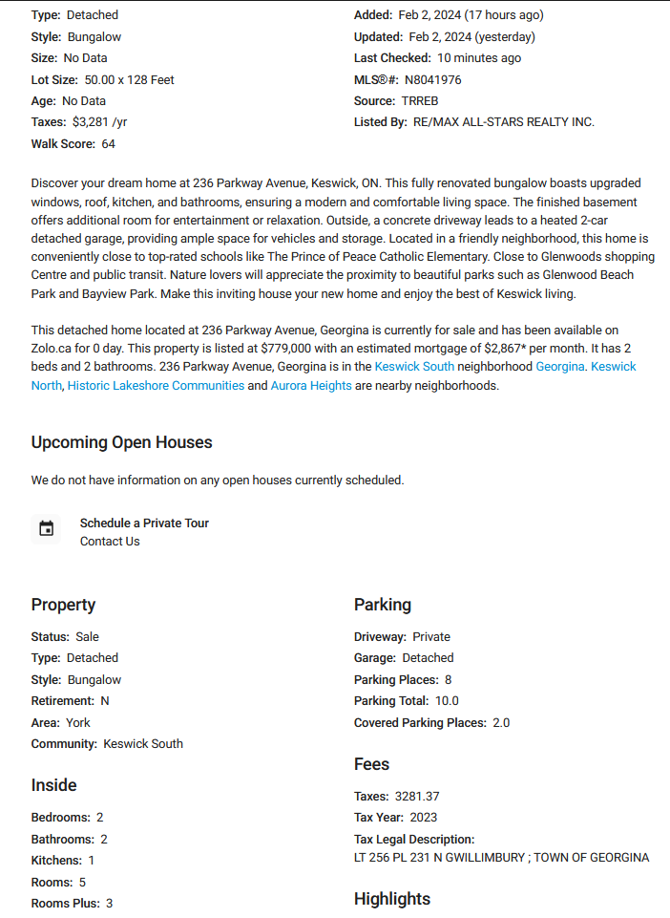
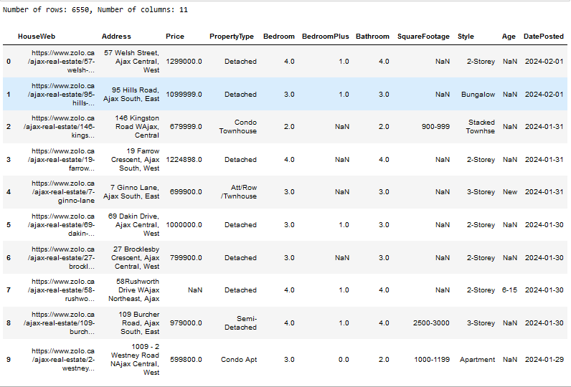
Your best quote that reflects your approach… “It’s one small step for man, one giant leap for mankind.”
SCRAP DATA
- Neil Armstrong

Slide 4
PROCESS FLOW PROBLEM DEFINITION DATA COLLECTION – WEB SCRAPING DATA CLEANING DATA ANALYSIS & VISUALIZATION CHALLENGES CONCLUSION
- Neil Armstrong

Slide 5
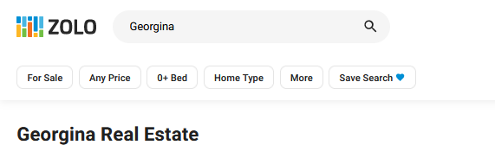
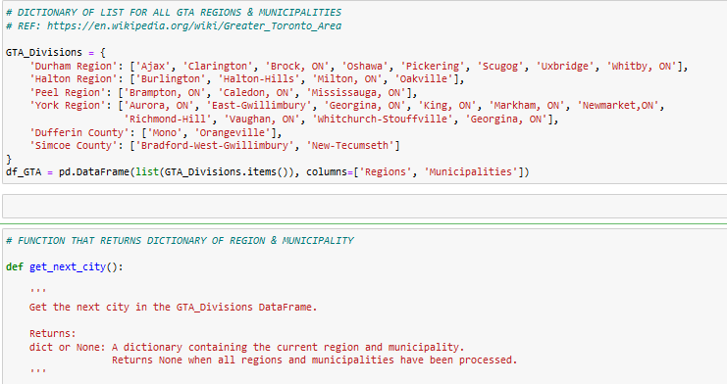
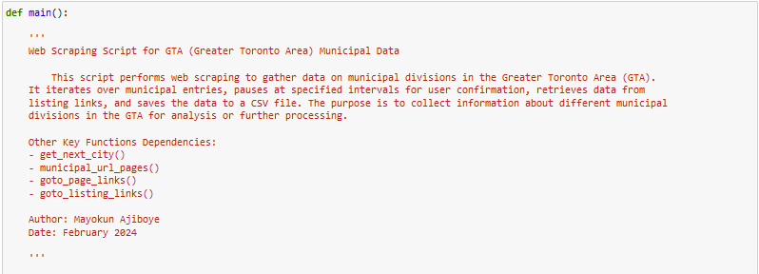
- Neil Armstrong
Selenium
Beautiful soup

Slide 6
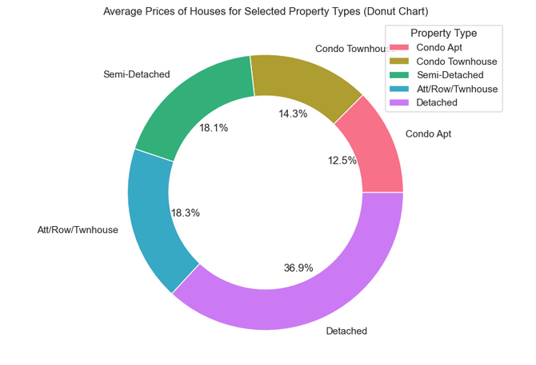
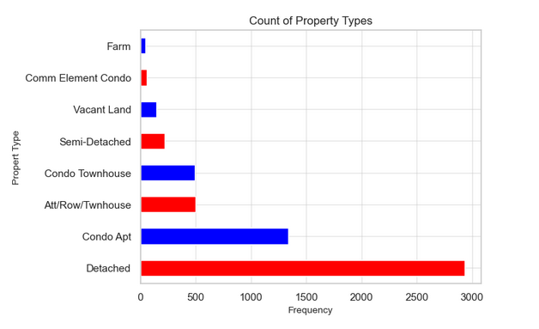
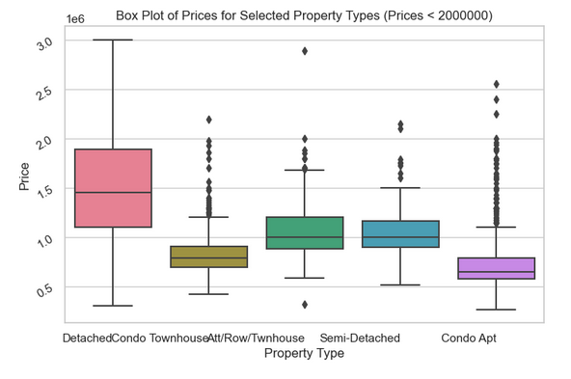
House Types

Slide 7
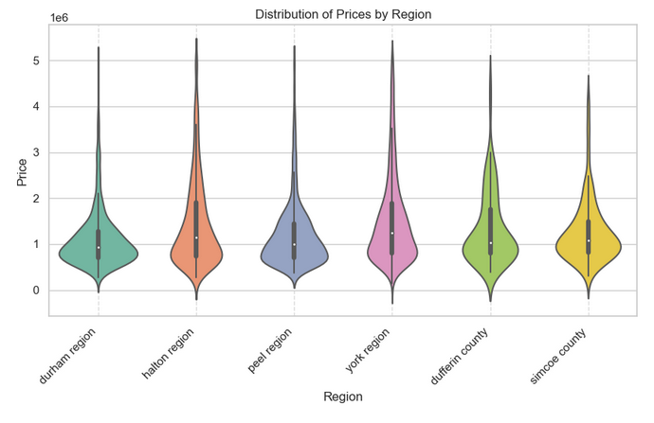
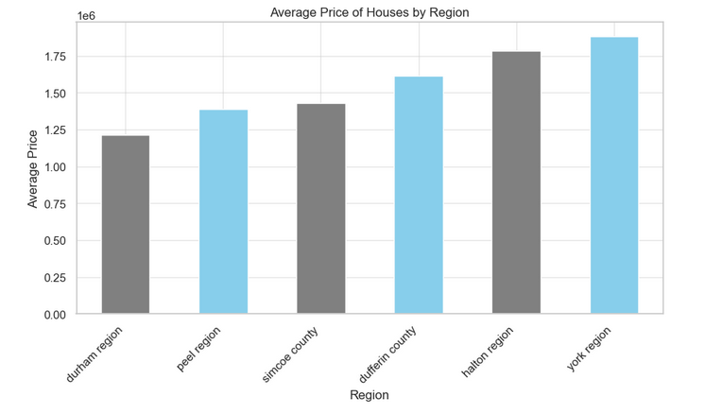
House Prices by Region

Slide 8
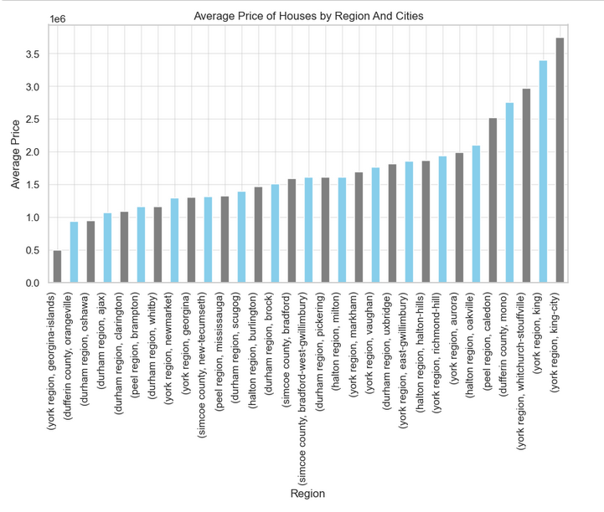
Average Prices By City

Slide 9
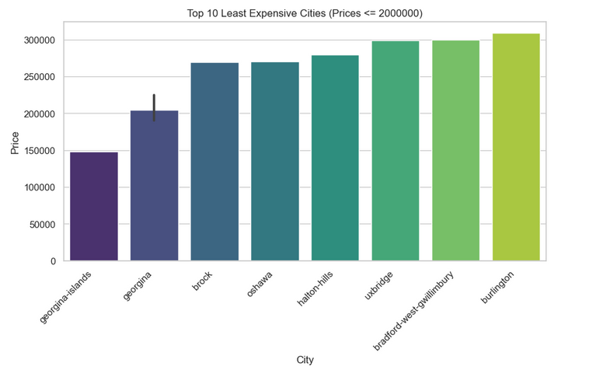
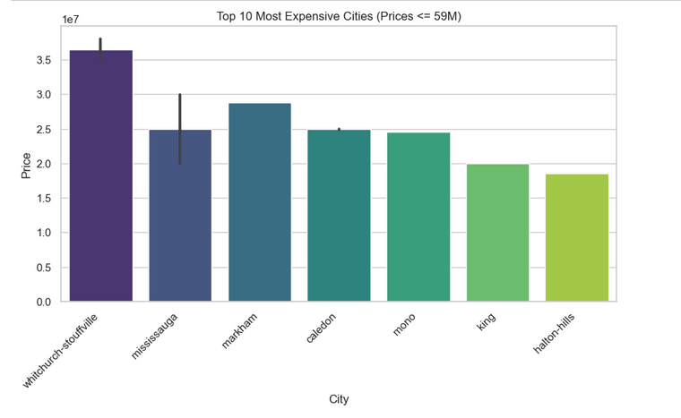
Least & Most Expensive Cities

Slide 10
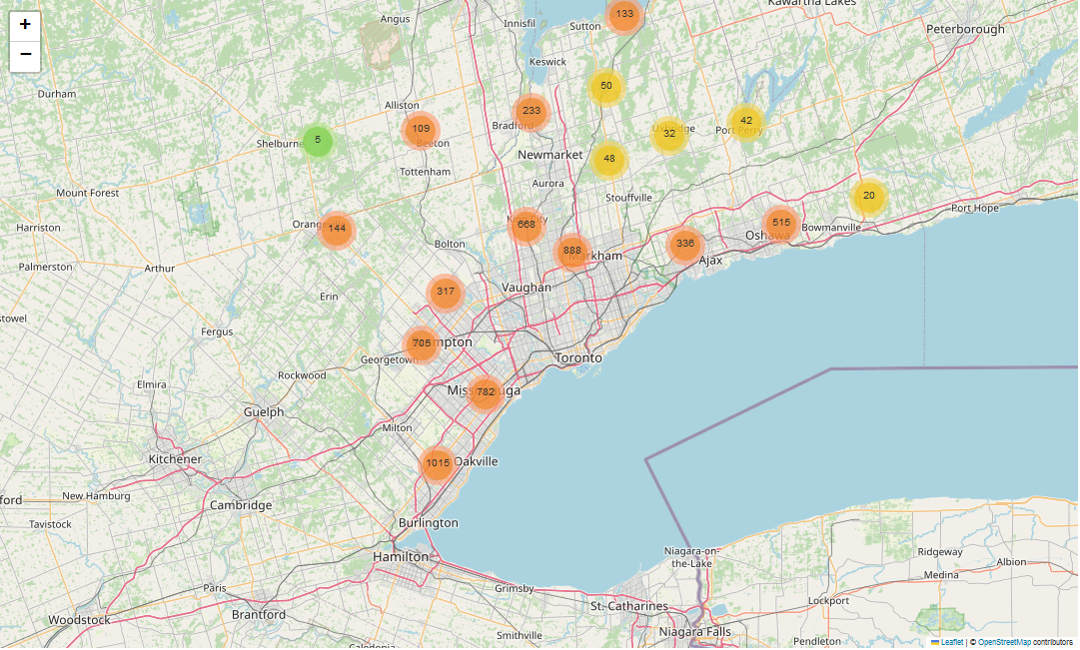
GTA House Listings Geo Distributions
Folium
geocoder

Slide 11
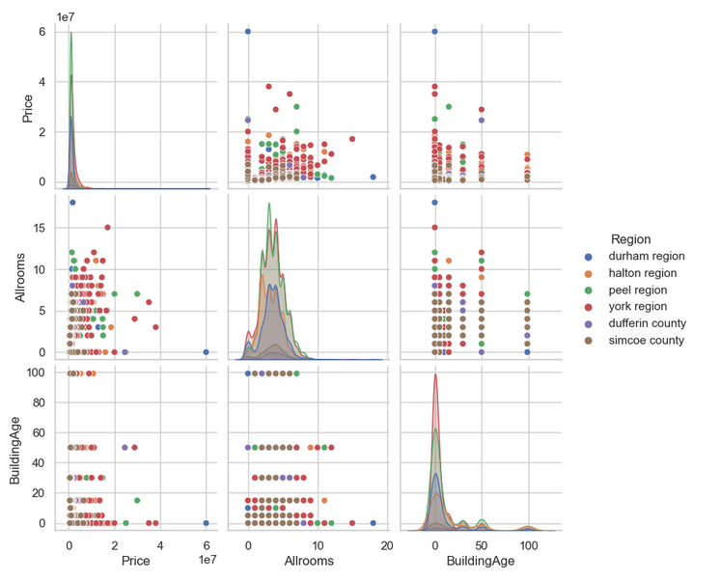
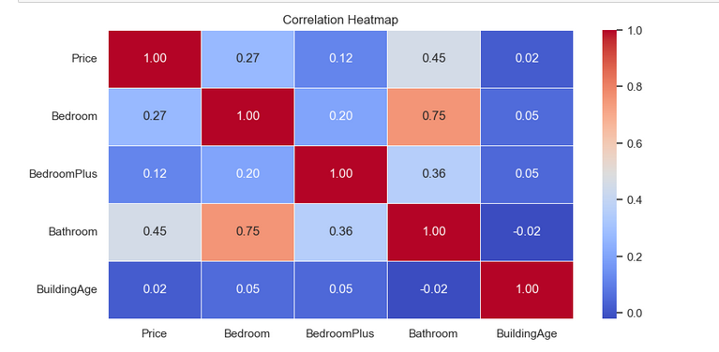
Potential Correlations

Slide 12
Challenges & Next Step
CHALLENGES
Blocked from scraping → Used API key
Continuous Data Cleaning → not one shot
NEXT STEP
Use other details
Square footage vs. price
Date Posted for Trends

Slide 13
Insights
Stakeholders including buyers, sellers, and investors can use the study to make informed decisions based on the current house price
The charts highlight areas around the GTA where house prices are more affordable like Georgina Island, Brock, Oshawa, ...
The most expensive houses are located outside the core of Toronto, in areas such as Stouffville, Mississauga, Markham, Mono, and King.

Slide 14
THANK YOU!

